Slide 1

Task 1: Web scraping to gain company insights

Slide 2
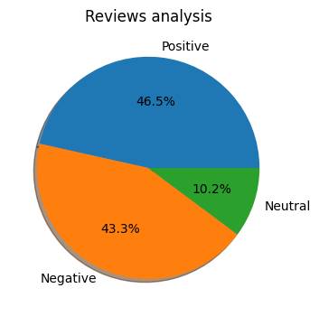
Analysis of Customer Reviews
Analysis of 1000 reviews given by customer, we found
Positive - 465
Negative - 433
Neutral - 102

Slide 3
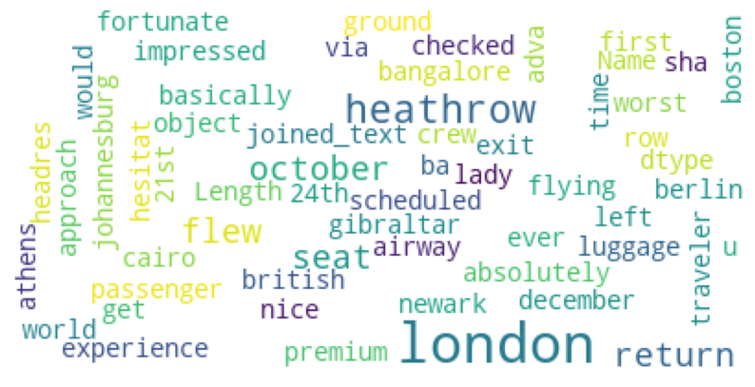
Word cloud of keywords used in Customer reviews

